Slide 1
Access Modifiers

Slide 2
Access Modifiers
The access modifiers specifies accessibility (scope) of a data member, method, constructor or class.
There are two types of modifiers in java: access modifiers and non-access modifiers.
There are 4 types of java access modifiers:
private
default
protected
public
There are many non-access modifiers such as static, abstract, synchronized, native, volatile, transient etc. Here, we will learn access modifiers.

Slide 3
Modifier | Description
Private | Declarations are visible within the class only
Default | Declarations are visible only within the package (package private)
Protected | Declarations are visible within the package or and all sub classes
Public | Declarations are visible everywhere

Slide 4
private access modifier
class A{
private int data=40;
private voidmsg()
{System.out.println("Hello java");}
}
public class Simple{
public static void main(String args[]){
A obj=new A();
System.out.println(obj.data);//Compile Time Error
obj.msg();//Compile Time Error
}
}
Role of Private Constructor
class A{
private A(){}//private constructor
void msg()
{System.out.println("Hello java");}
}
public class Simple{
public static void main(String args[]){
A obj=new A();//Compile Time Error
}
}

Slide 5
default access modifier
//save by A.java
package pack;
class A{
void msg(){System.out.println("Hello");}
}
//save by B.java
package mypack;
import pack.*;
class B{
public static void main(String args[]){
A obj = new A();//Compile Time Error
obj.msg();//Compile Time Error
}
}

Slide 6
protected access modifier
//save by A.java
package pack;
public class A{
protected void msg(){System.out.println("Hello");}
}
//save by B.java
package mypack;
import pack.*;
class B extends A{
public static void main(String args[]){
B obj = new B();
obj.msg();
}
}
Output:Hello

Slide 7
public access modifier
//save by A.java
package pack;
public class A{
public void msg(){System.out.println("Hello");}
}
//save by B.java
package mypack;
import pack.*;
class B{
public static void main(String args[]){
A obj = new A();
obj.msg();
}
}
Output:Hello

Slide 8
Access Modifier | within class | within package | outside package by subclass only | outside package
Private | Y | N | N | N
Default | Y | Y | N | N
Protected | Y | Y | Y | N
Public | Y | Y | Y | Y

Slide 9
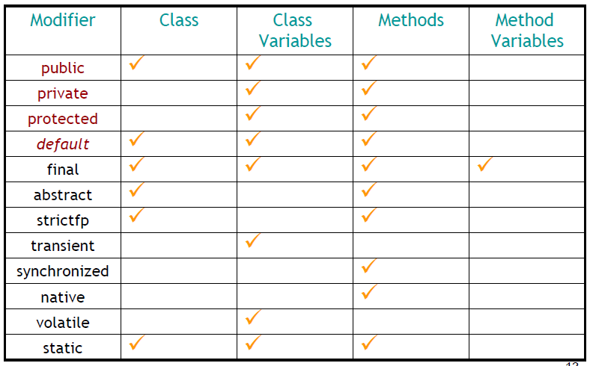

Slide 10
Modifiers - class
public
– Class can be accessed from any other class present in any package
• default
– Class can be accessed only from within the same package. Classes outside the
package in which the class is defined cannot access this class
• final
– This class cannot be sub-classed, one cannot extend this class
• abstract
– Class cannot be instantiated, need to sub-classs/extend.
• strictfp
– Conforms that all methods in the class will conform to IEEE standard rules for
floating points

Slide 11
Modifiers – Class Attributes
• final
– This value of the attribute cannot be changed, can assign only 1 value
• transient
– The attribute value cannot be serialized
• volatile
– Thread always reconciles its own copy of attribute with master.
• static
– Only one value of the attribute per class

Slide 12
Modifiers – Methods
• public
– Method can be accessed from any other class present in any package
• private
– Method can be accessed from only within the class
• protected
– Method can be accessed from all classes in the same package and sub-classes.
• default
– Method can be accessed only from within the same package.
• final
– The method cannot be overridden
• abstract
– Only provides the method declaration
• strictfp
– Method conforms to IEEE standard rules for floating points
• synchronized
– Only one thread can access the method at a time
• native
– Method is implemented in platform dependent language
• static
– Cannot access only static members.

Slide 13
Package
A java package is a group of similar types of classes, interfaces and sub-packages.
Packages are divided into two categories:
Built-in Packages (packages from the Java API)
User-defined Packages (create your own packages)
Advantage of Java Package
1) package is used to categorize the classes and interfaces so that they can be easily maintained.
2) provides access protection.
3) removes naming collision

Slide 14
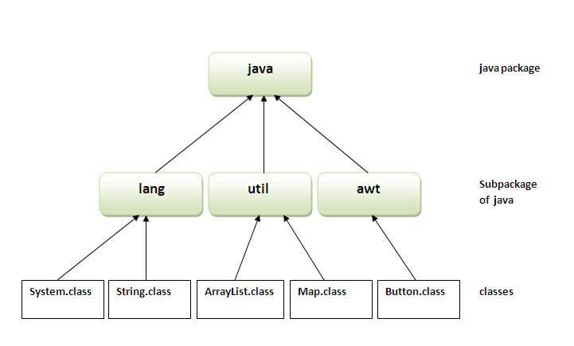
There are many built-in packages such as java, lang, awt, javax, swing, net, io, util, sql etc.

Slide 15
Simple example of java package
//save as Simple.java
package mypack;
public class Simple{
public static void main(String args[]){
System.out.println("Welcome to package");
}
}
How to compile java package
If you are not using any IDE, you need to follow the syntax given below:
javac -d directory javafilename
For example
javac -d . Simple.java

Slide 16
How to run java package program
You need to use fully qualified name e.g. mypack.Simple etc to run the class.
To Compile: javac -d . Simple.java
To Run: java mypack.Simple
Output:Welcome to package
The -d is a switch that tells the compiler where to put the class file i.e. it represents destination. The . represents the current folder.

Slide 17
How to access package from another package?
There are three ways to access the package from outside the package.
1. import package.*;
2. import package.classname;
3. fully qualified name

Slide 18
1) Using packagename.*
Example of package that import the packagename.*
//save by A.java
package pack;
public class A{
public void msg(){System.out.println("Hello");}
}
//save by B.java
package mypack;
import pack.*;
class B{
public static void main(String args[]){
A obj = new A();
obj.msg();
}
}
Output:Hello

Slide 19
2) Using packagename.classname
//save by A.java
package pack;
public class A{
public void msg(){System.out.println("Hello");}
}
//save by B.java
package mypack;
import pack.A;
class B{
public static void main(String args[]){
A obj = new A();
obj.msg();
}
}
Output:Hello

Slide 20
3) Using fully qualified name
//save by A.java
package pack;
public class A{
public void msg(){System.out.println("Hello");}
}
//save by B.java
package mypack;
class B{
public static void main(String args[]){
pack.A obj = new pack.A();//using fully qualified name
obj.msg();
}
}
Output:Hello

Slide 21
Mcqs
1. Suppose a class has public visibility. In this class we define a protected method. Which of the following statements is correct?
A. This method is only accessible from inside the class itself and from inside all subclasses.
B. In a class, you cannot declare methods with a lower visibility than the visibility of the class in which it is defined.
C. From within protected methods you do not have access to public methods.
D. This method is accessible from within the class itself and from within all classes defined in the same package as the class itself.

Slide 22
2. Consider the following two classes declared and defined in two different packages, what can be added in class B to form what considered a correct access to class A from main() method of class B?
package subPackage;
public class A { }
package anotherPackage;
// line 1
public class B{
public static void main(String[] args){
// line 2
}
}
1. At line1 add noting; At line2 add: new A();
2. At line 1 add: import package.*; at line 2 add : new subPackage.A();
3. At line 1 add: import subPackage.*; at line 2 add : new A();
4. At line 1 add: import subPackage.A; at line 2 add : new A();
Options
A. 1 and 2
B. 2 and 4
C. 3 and 4
D. 1 and 3

Slide 23
3. Which statements are most accurate regarding the following classes?
class A{
private int i;
protected int j;
}
class B extends A{
private int k;
protected int m;
}
A. An object of B contains data fields i, j, k, m.
B. An object of B contains data fields j, k, m.
C. An object of B contains data fields j, m.
D. An object of B contains data fields k, m.

Slide 24
4. A package is a collection of
A. Classes
B. Interfaces
C. Editing tools
D. Classes and Interfaces
E. Editing tools and Interfaces
5. What can directly access and change the value of the variable qusNo?
package com.mypackage;
public class Test{
private int qusNo = 100;
}
A. Only the Test class.
B. Any class.
C. Any class in com.mypackage package.
D. Any class that extends Test.
E. None of these

Slide 25
Answers
D
C
B
D
A

